Slide 1
Coffee with Cobb
@cobbtechnologies
@cobbtechnologies
@cobbtech
cobbtechnologies.com

Slide 2
Production Print Demo
cobbtechnologies.com

Slide 3
Today’s Presenters
Travis Brigham
David DiGiacamo
Production Print Product Manager
VP of Sales Development
cobbtechnologies.com

Slide 4
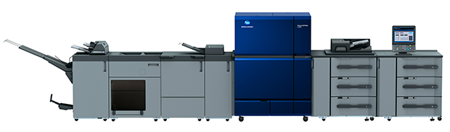
Konica C14000/C12000
140/120 ppm
Up to 450 gsm paper weight in simplex and duplex printing
Automated inline business card and postcard cutting
Full-bleed brochures, book jackets, banners and posters
cobbtechnologies.com

Slide 5
Canon C10010/9010
100/90 ppm
In-Line Spectrophotometric Sensors provide automatic color calibration, media profiling, and profile verification.
Dual Fixing Technology helps maintain high productivity even on complex jobs.
Diversify your application offerings by printing on stocks up to 51.2” in length.
cobbtechnologies.com

Slide 6
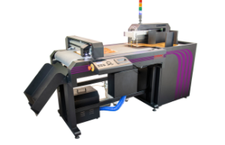
Intec ColorCut FB-8000
The ColorCut FB8000 uses a dual tool cutting/ creasing carriage head.
Auto Sheet Feeder Enables fully automatic sheet placement and cutting with FB8000
QR coded Job Library for file retrieval
cobbtechnologies.com

Slide 7
Thank you for
Joining us.
For any other Questions contact us at
coffee@cobbtechnologies.com

